Slide 1
Classification Assignment

Slide 2
Problem Statement or Requirement
Identify your problem statement
Need to build the best model to predict and classify the Chronic Kidney Disease (CKD).
2. Tell basic info about the dataset (Total number of rows, columns)
Rows – 399
Columns – 25
3. Mention the pre-processing method if you’re doing any (like converting string to number – nominal data)
Yes, need to convert few string columns to number (dataset=pd.get_dummies(dataset,drop_first=True))
After converting string to number : Rows – 399 & columns – 28
4. Develop a good model with good evaluation metric. You can use any machine learning algorithm; you can create many models. Finally, you have to come up with final model.
Final Model – Random Forest – GridSearch
5. All the research values of each algorithm should be documented. (You can make tabulation or screenshot of the results.)
Screenshot updated in the below slides for each algorithm.
6. Mention your final model, justify why u have chosen the same.
Final model chosen as Random Forest – GridSearch because compared to other model the below listed count are high.
Overall performance of the model (Accuracy)
Percentage of correctly classified (Recall)
Percentage of correctly & wrongly classified (Precision)
Overall Performance – Recall & Precision (F1-score)
Average Performance - Recall, Precision & F1-score (Macro-Average)
Proportion

Slide 3

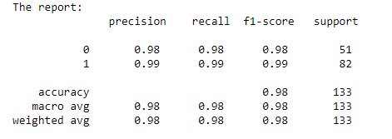
Random Forest – Grid Search
ROC-AOU score - 0.9933046389287422

Slide 4

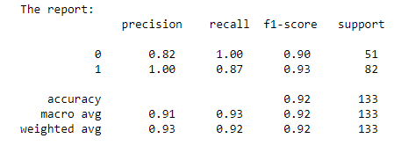
Decision Tree – Grid Search
ROC-AOU score - 0.9329268292682926

Slide 5

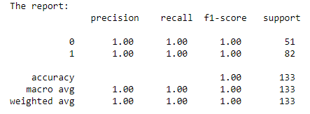
SVM – Grid Search
ROC-AOU score - 0.1

Slide 6

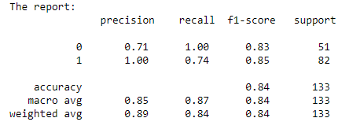
Logistic Regression – Grid Search
ROC-AOU score - 0.9985652797704447

